Slide 1

Automated Fan Control System
Microprocessor-Based Real-World Application Project
by: Dalianna M. Mojica Cotto (S01521543)
Prof. Daniel E. Mera Romo

Slide 2
Introduction
The project focuses on designing and implementing an automated ventilation control system using an Arduino Uno microcontroller. The system integrates multiple sensing modules—including a real-time clock (DS3231), a digital temperature sensor (DS18B20), and a PIR motion sensor (HC-SR501)—to activate a ventilator based on environmental and temporal conditions. An LCD I2C display provides real-time feedback to the user, while a relay module enables safe switching of the ventilator. The purpose of the project is to apply microprocessor concepts in a real-world application that enhances comfort, energy efficiency, and autonomous operation.

Slide 3
Design Process
1. Problem Identification
A ventilation system was required to activate automatically based on environmental conditions.
The system needed to respond to temperature, motion detection, and a specific time schedule.

Slide 4
2. Requirements Definition
Read real-time temperature (DS18B20).
Maintain precise timing for scheduled activation (DS3231 RTC).
Detect motion in the surrounding area (PIR HC-SR501).
Display system information on an LCD I2C.
Control a high-voltage ventilator using a relay.
Implement all logic using an Arduino Uno R3.

Slide 5

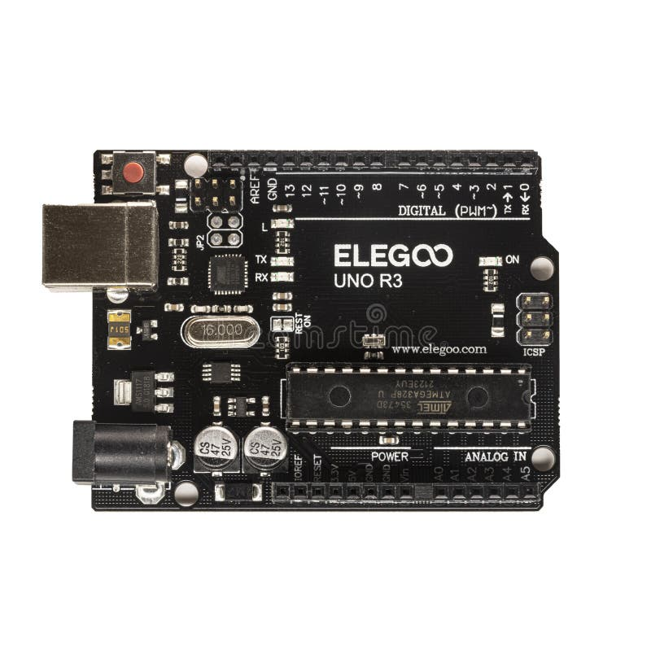
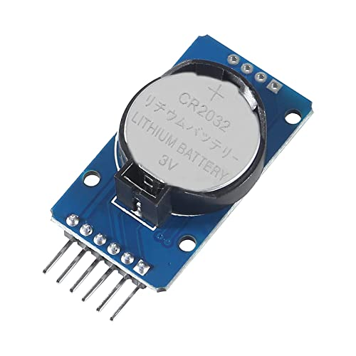
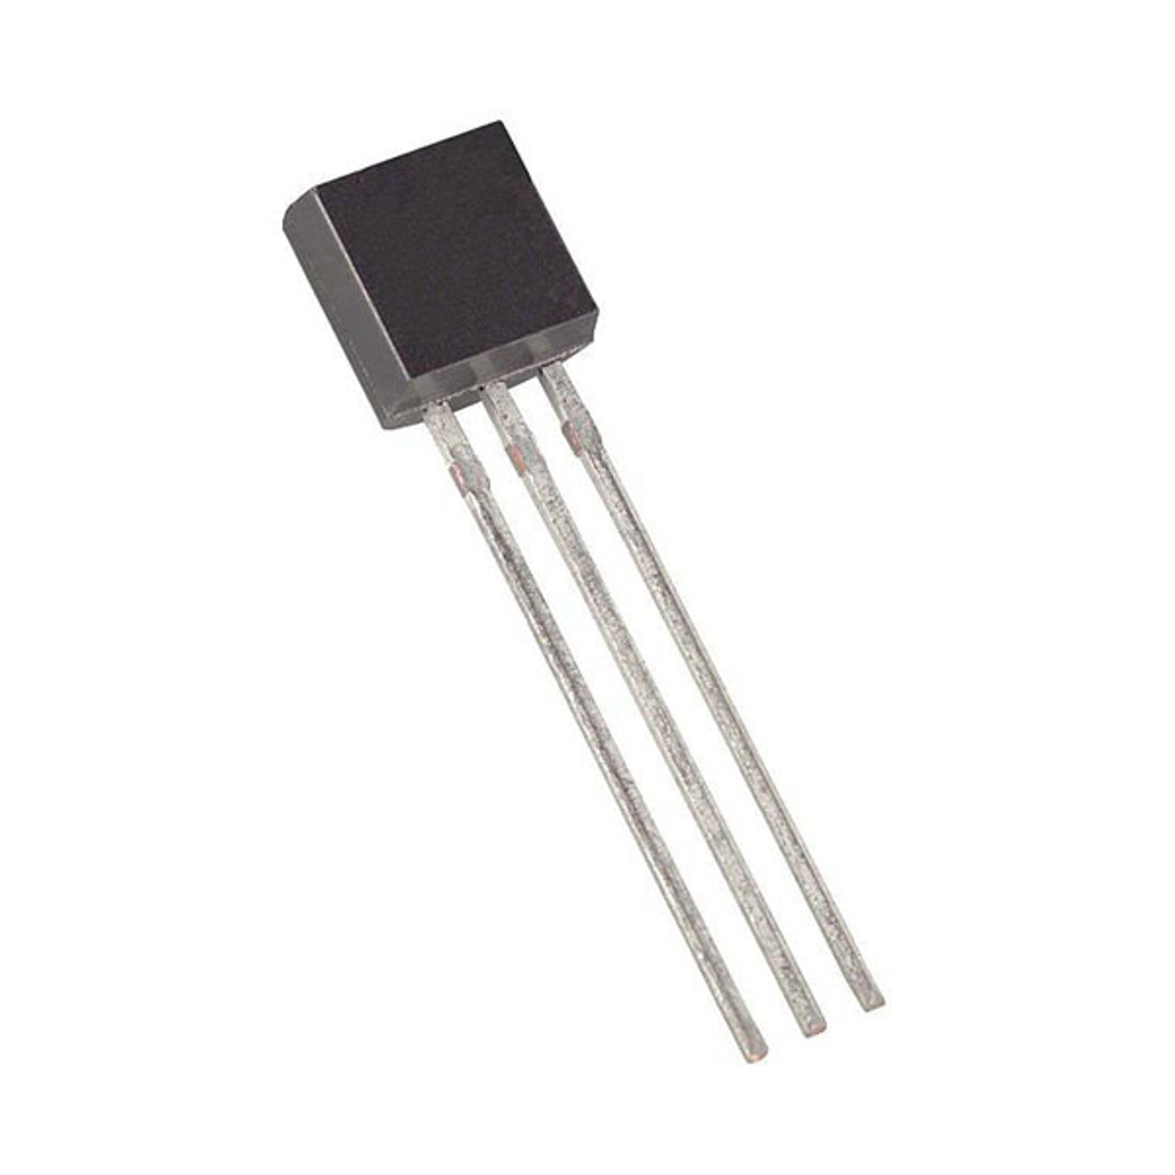
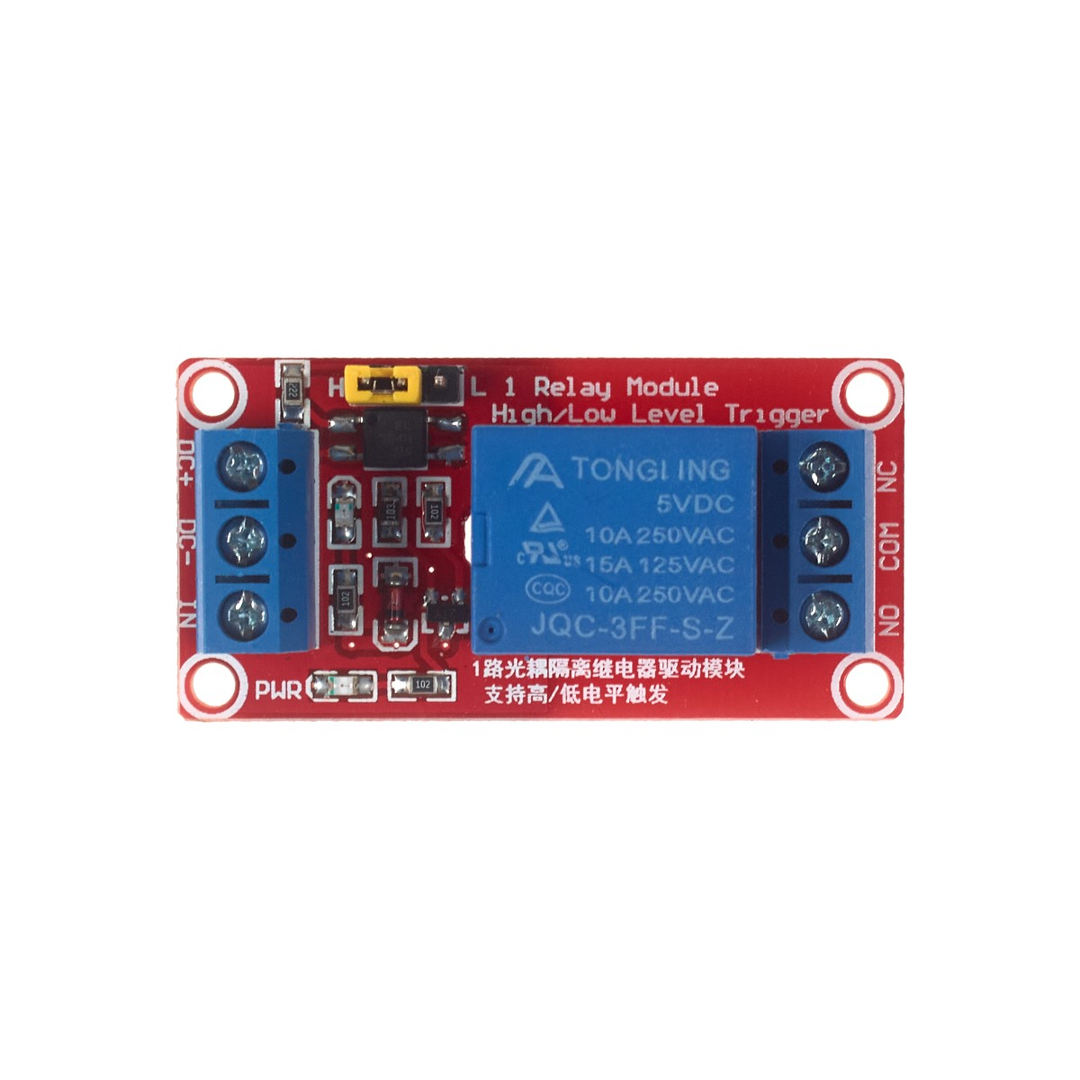
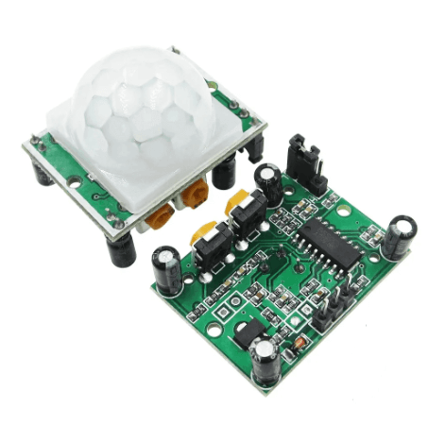
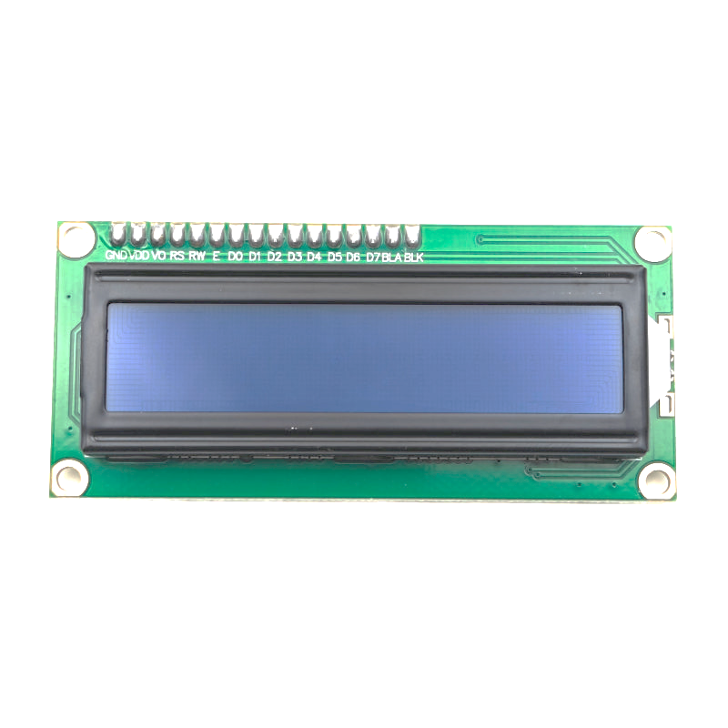
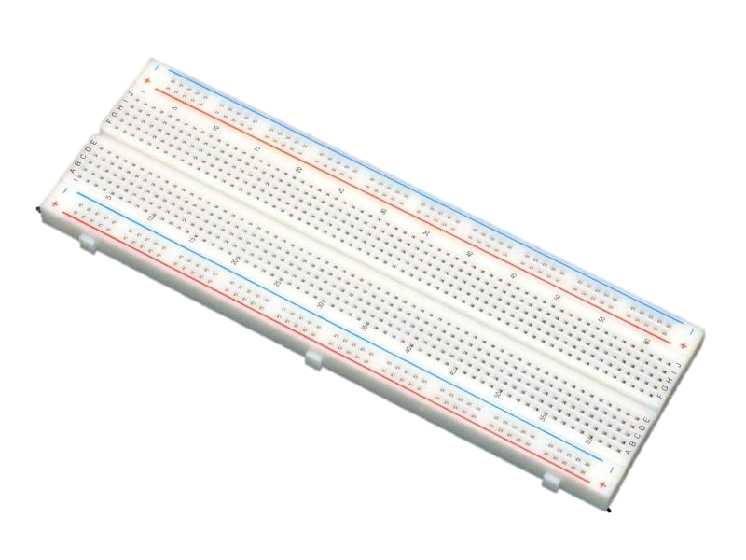
3. Component Selection
Arduino Uno R3 as the main controller.
DS3231 RTC for accurate timekeeping.
DS18B20 for reliable digital temperature measurement.
HC-SR501 PIR for motion detection.
JQC-3FF-S-Z relay for switching the ventilator.
LCD I2C display for visual feedback.
Breadboard and jumpers for prototyping.

Slide 6
Table 1. Cost table
Component | Quantity | Unit Price (USD) | Total Cost (USD)
Double Outlet Cover – Ivory | 1 | 0.45 | 0.45
DS18B20 Digital Temperature Sensor | 1 | 1.00 | 1.00
Receptacle 15A/125V – Ivory | 1 | 1.19 | 1.19
Shielded Plug 15A/125V w/ Ground | 1 | 1.89 | 1.89
CR2032 Battery | 1 | 2.08 | 2.08
PIR Motion Sensor HC-SR501 | 1 | 2.95 | 2.95
PVC Electrical Box 4x4 | 1 | 1.49 | 1.49
DS3231 AT24C32 IIC RTC Module | 1 | 4.95 | 4.95
20" Box Fan – White EZ Chill | 1 | 24.99 | 24.99
TOTAL PROJECT COST | — | — | 41.98 USD

Slide 7
4. System Architecture Design
DS3231 RTC connected to Arduino via I2C bus → SDA → A4, SCL → A5, VCC → 5V, GND → GND
DS18B20 Temperature Sensor using OneWire → Data → D4, VCC → 5V, GND → GND, 4.7kΩ pull-up between Data and VCC
HC-SR501 PIR Motion Sensor → OUT → D3, VCC → 5V, GND → GND
JQC-3FF-S-Z Relay Module controlling the ventilator → IN → D7, VCC → 5V, GND → GND, switching the fan externally
LCD I2C (0x27) → SDA → A4, SCL → A5, shared with RTC
Power Distribution → 5V and GND rails distributed through the breadboard for all modules

Slide 8
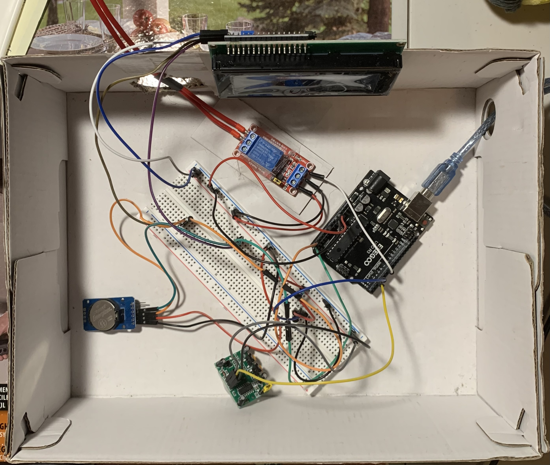
Figure 1. Photo of the physical circuit (Hardware part)

Slide 9
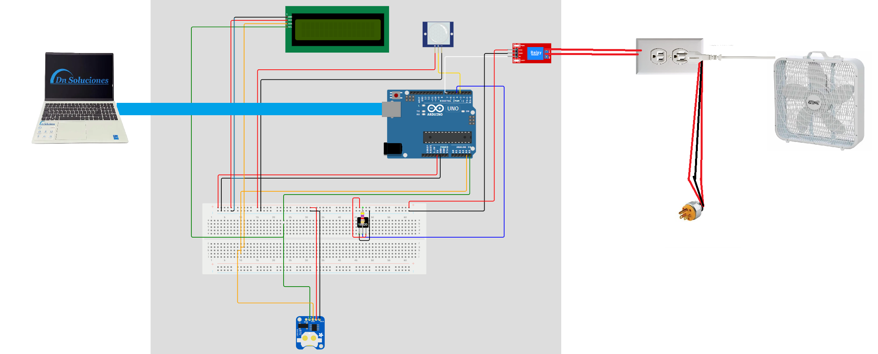
Figure 2. Circuit design

Slide 10

5. Algorithm Development
Define conditions for activating the ventilator:
Temperature
Time
PIR motion detected
Build a priority-based decision structure.
Implement real-time updates on the LCD without full display refresh.

Slide 11
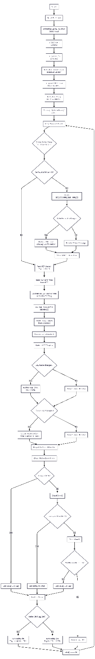
Figure 3: Main Program Flowchart

Slide 12
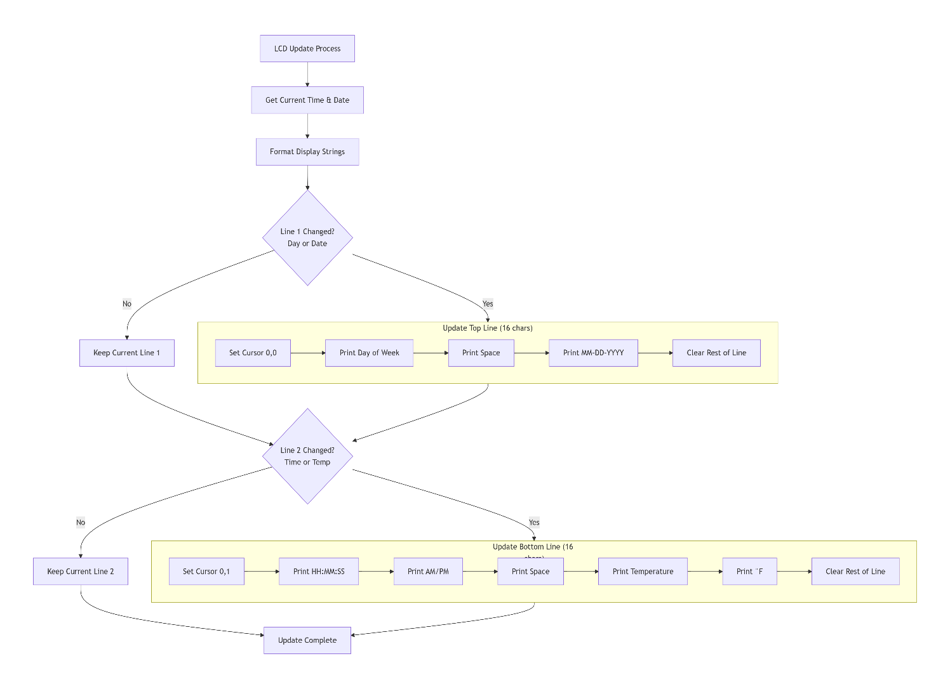
Figure 4: LCD Display
12

Slide 13
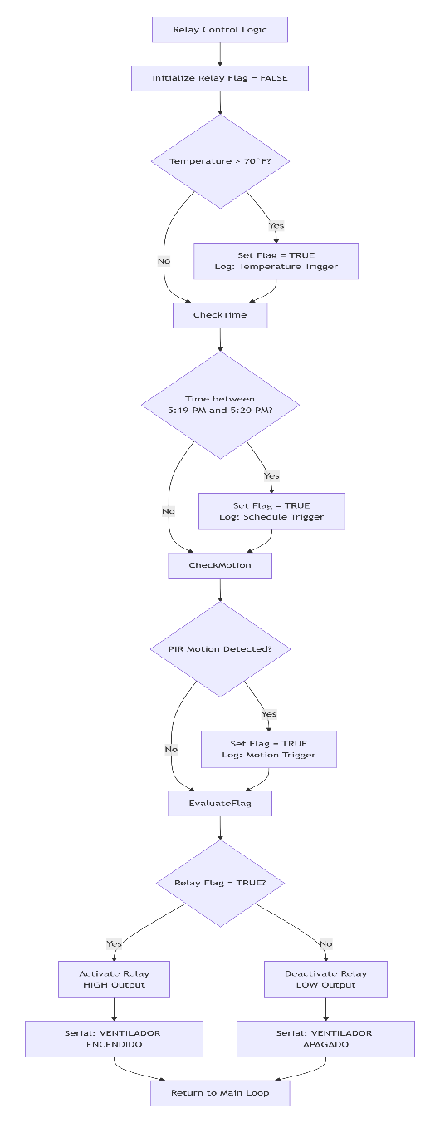
Figure 5: Relay Control Decision Logic

Slide 14
6. Coding and Integration
Library Setup: Included RtcDS3231, LiquidCrystal_I2C, OneWire, and DallasTemperature to interface the RTC, LCD, and DS18B20 sensor.
Sensor Reading Logic: Implemented periodic temperature requests, 12-hour time formatting, and PIR state detection through digital pin polling.
Time Adjustment Interface: Added a serial command parser (SET,YYYY,MM,DD,HH,MM,SS) to allow real-time clock updates directly from the Serial Monitor.
Display Handling: Optimized LCD output by updating only changed characters to prevent flickering and reduce I2C traffic.
Relay Control Algorithm: Combined temperature threshold, scheduled time window, and motion detection into a unified decision structure to activate the relay on pin D7.
System Debug Output: Enabled detailed serial logs for time, date, temperature, and trigger sources for easier troubleshooting.

Slide 15
7. Hardware Prototyping
Full circuit assembled on a breadboard.
Wiring validated for correctness and reliability.
Modules tested one by one, then fully integrated.

Slide 16
8. Testing and Troubleshooting
Verified temperature readings and time accuracy.
Checked PIR responsiveness.
Ensured the relay activated under the correct conditions.
Adjusted LCD refresh to avoid flickering and ghosting.

Slide 17
9. Final Validation
All conditions triggered the ventilator as expected.
Display updated correctly with time, date, AM/PM, and temperature.
System ran continuously and reliably for extended tests.

Slide 18
Challenges Encountered During the Project Development
Software Issues and Solutions
Missing RTC Library The library RtcDS3231.h was not installed, preventing the RTC from displaying the correct time on the LCD. Solution: The required library was added to the Arduino IDE, allowing proper communication with the DS3231 module.
RTC Showing Time 10 Minutes Behind The clock displayed a 10-minute delay. Solution: The issue was corrected by manually adjusting the RTC time through the serial command implemented in the code (SET,YYYY,MM,DD,HH,MM,SS).
Fan Not Activating During Initial Test The program was configured to turn on the fan at 4:00 AM, but testing was performed at 4:00 PM due to confusion between AM and PM in the 12-hour format. Solution: The time logic was reviewed and corrected to ensure consistent AM/PM handling.
LCD Flickering Issue The LCD flashed every second because the code refreshed the entire display whenever values like seconds or temperature decimals changed. Solution: The code was optimized to update only the characters that changed, eliminating full-screen refresh and resulting in smoother, stable visual updates.

Slide 19
Safety Measures and Additional Notes
Electrical Safety Precautions
Special care was taken when connecting the AC-powered fan to the relay module.
A cardboard insulator was placed under the relay to prevent accidental contact with conductive surfaces.
The relay was also secured with tape to avoid movement during operation.
Connections were made with the system disconnected from wall power to prevent electrical hazards.
Final Note
All issues encountered during the project were software-related, not hardware failures.

Slide 20
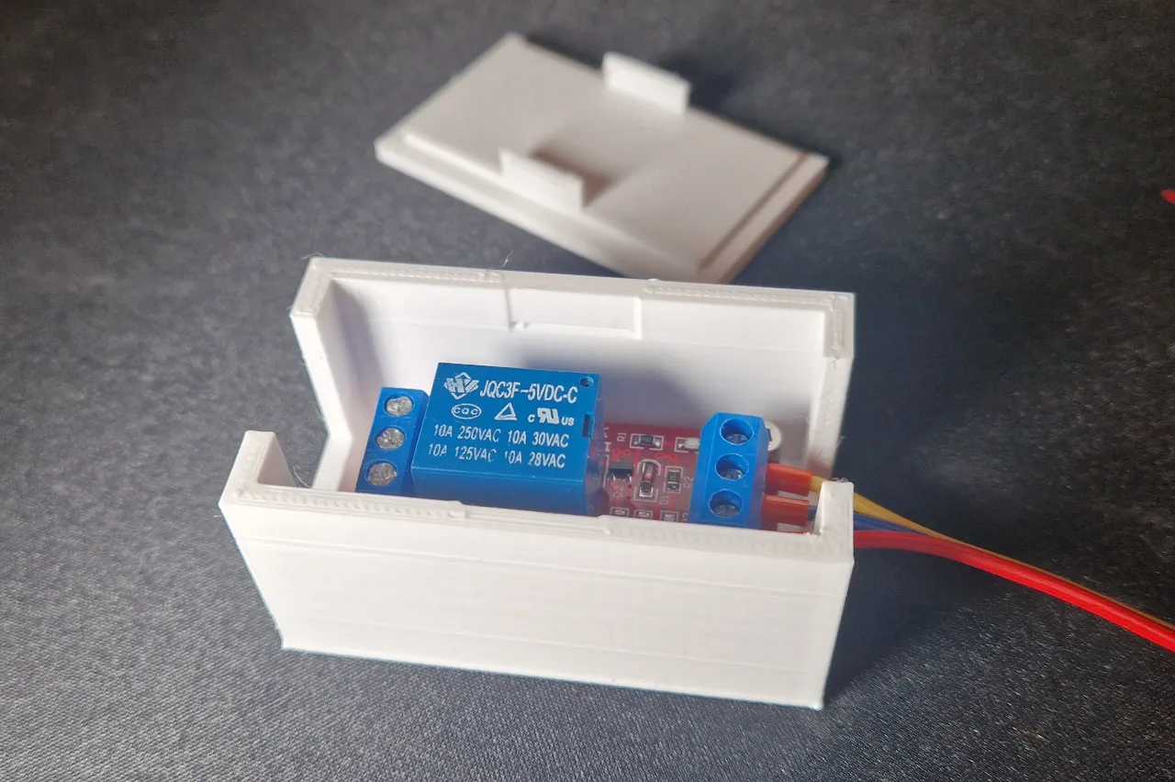
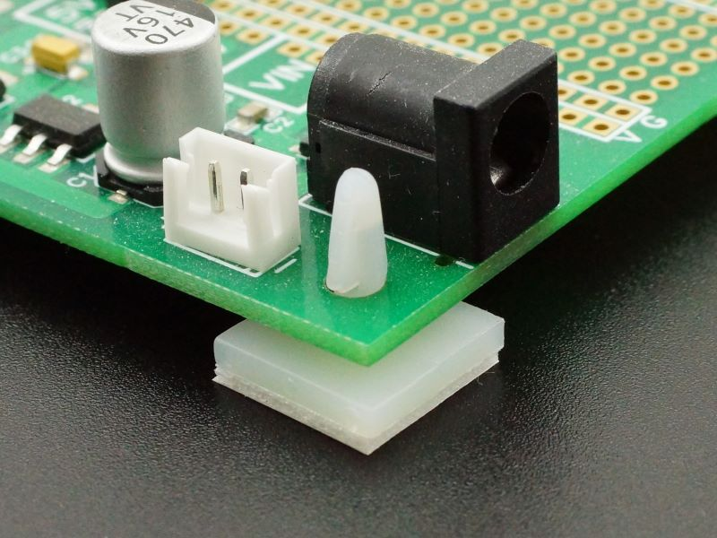
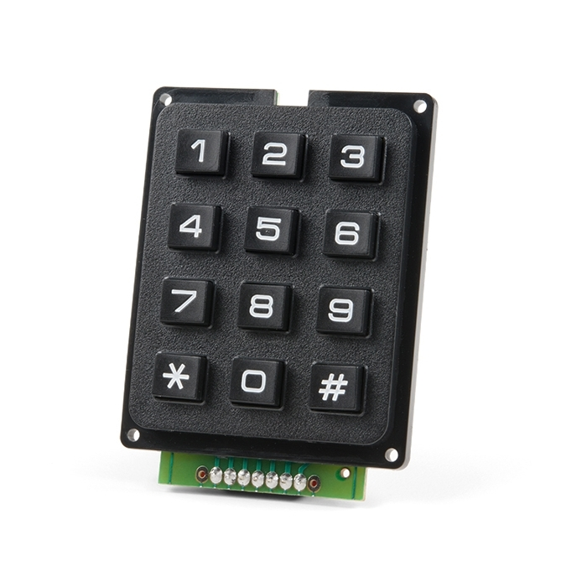
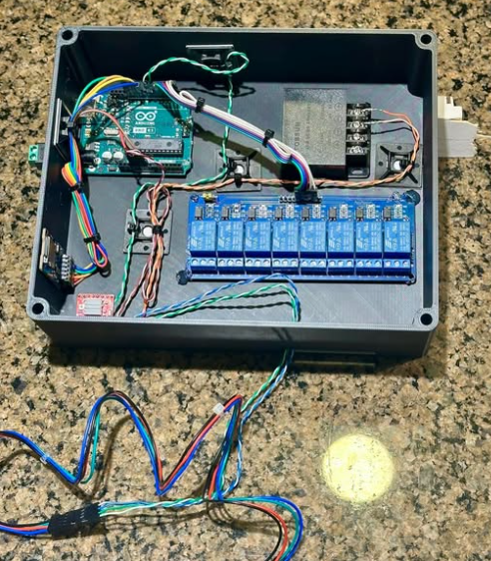
Future Improvements (Hardware & Software)
Hardware Enhancements
Add a 3D-printed relay enclosure to enhance electrical safety when switching AC loads.
Replace the cardboard relay support with nylon standoffs.
Add buttons or a keypad for real-time user input (e.g., changing thresholds or schedules without reprogramming).
Include an enclosure for the entire system to protect components and improve presentation.

Slide 21

Software Enhancements
Add a menu system on the LCD to adjust time, temperature threshold, or schedules directly from the hardware.
Implement data logging (temperature, motion, fan activation) using the AT24C32 memory or SD-card module.
Add hysteresis control to prevent the fan from turning on/off repeatedly around the threshold temperature.
Include debounce logic for PIR detection or motion filtering to improve accuracy.
Develop a WiFi or Bluetooth version using ESP32 or HC-05 to control and monitor the system remotely.
Optimize power consumption by using sleep modes when no motion is detected.

Slide 22


Conclusion
This project successfully integrated multiple sensors and modules—such as the DS3231 RTC, DS18B20 temperature sensor, PIR motion detector, relay module, and LCD display—into a functional automated ventilation control system. All issues encountered during development were related to software and were resolved through debugging, library installation, display optimization, and time-format corrections. The final prototype demonstrates reliable performance and accurate control based on temperature, schedule, and motion detection.

Slide 23
References
Maxim Integrated. (2015). DS18B20: Programmable resolution 1-Wire digital thermometer (Rev. 5). Maxim Integrated. [https://datasheets.maximintegrated.com/en/ds/DS18B20.pdf]
Datasheet PDF desde MPJA: [https://www.mpja.com/download/31227sc.pdf]
Ficha técnica / pinout en Components101: [https://components101.com/sensors/hc-sr501-pir-sensor]
Monk, S. (2016). Programming Arduino: Getting started with sketches (2nd ed.). McGraw-Hill Education.
OpenAI. (2025). ChatGPT (GPT-5.1) [Large language model]. https://chat.openai.com/

